Slide 1
REAL-TIME FINGER SPELLING AMERICAN SIGN LANGUAGE RECOGNITION USING DEEP CONVOLUTIONAL NEURAL NETWORKS
A Thesis Submitted by
Lokesh Kumar Viswavarapu
Graduate Student, MSEE
Guided by
Dr. Kamesh Namuduri
Dr. Bill P. Buckles

Slide 2
Contents
Introduction
Problem Statement
Motivation
Literature Review
Our Approach
Challenges
System Design
Implementation
Results
Discussion
Future Work
Conclusion

Slide 3
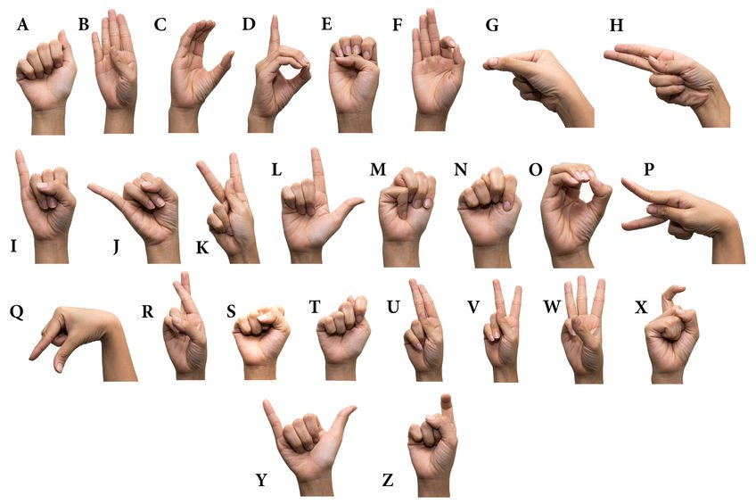
Introduction
Finger Spelling American Sign Language:
American Sign Language(ASL) is one of the predominant sign languages, used as an alternative way of communication by differently abled community who has challenges in hearing and speaking. Finger spelling ASL deals with a set of hand signatures to represent English alphabet.

Slide 4
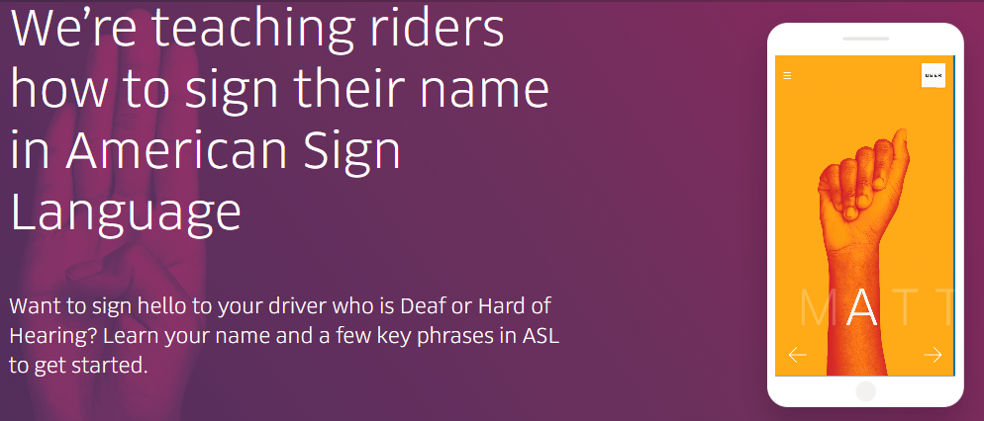
Problem Statement
Understanding American sign language is a barrier for communication with general public, as it is pursued as a special skill by a small set of people on need basis.
It is estimated that only 250,000-500,000 people (without disability) around the globe are proficient in American sign language [1]

Slide 5
Motivation
The foundation of our work is IEEE’s philosophy of “Advancing technology for humanity”
Our motivation is:
To develop a personal assistive system for specially-abled community with challenges in hearing and speaking.
To utilize the recent advancements in computer vision and artificial intelligence for engineering our solution.

Slide 6
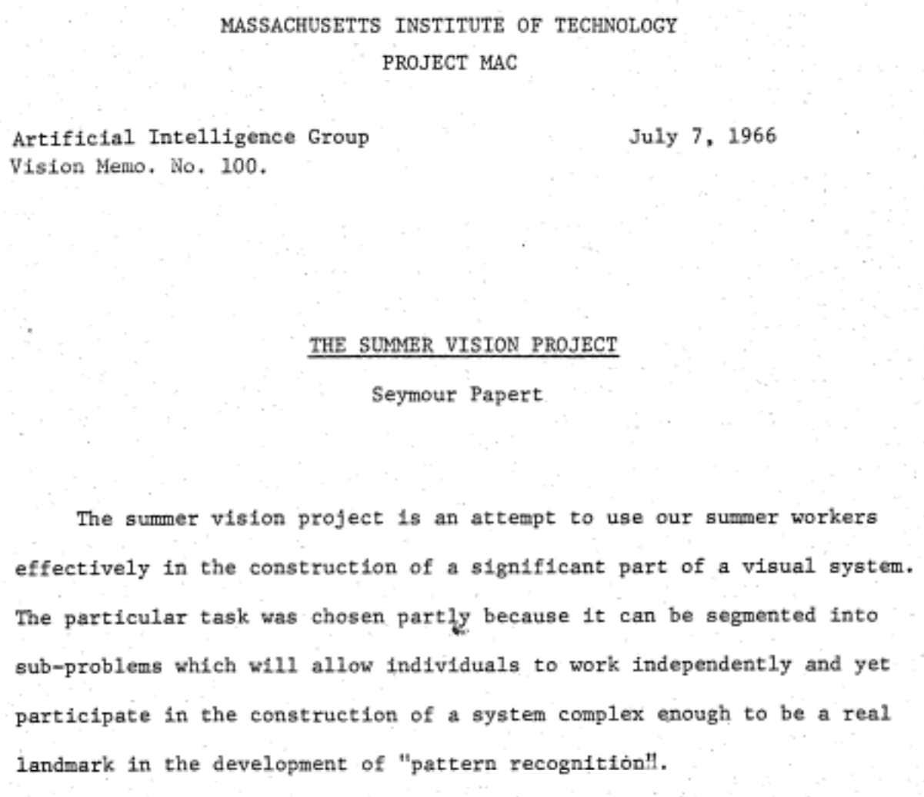
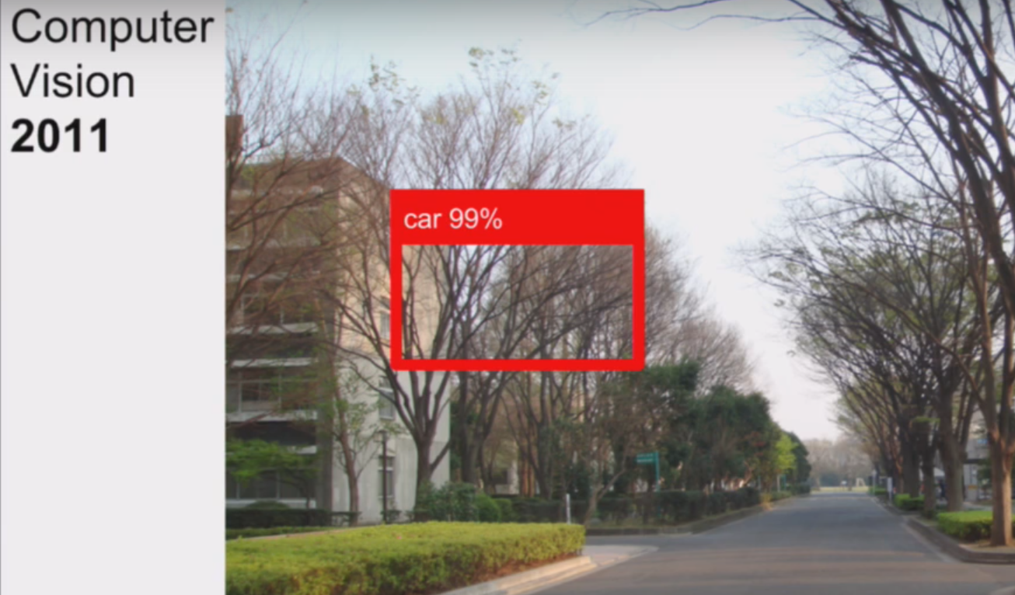
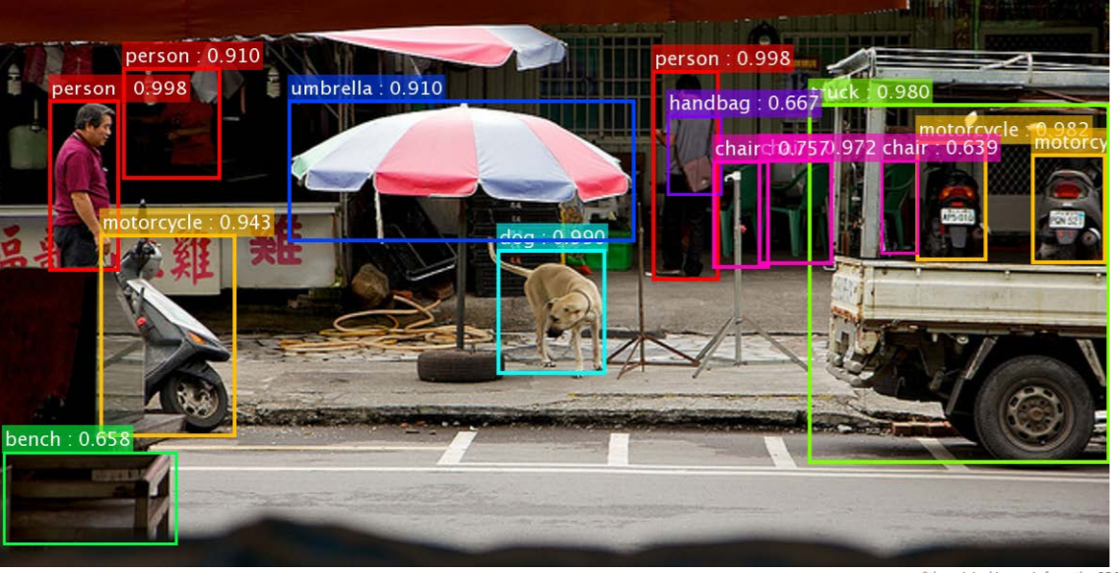
Advancements in Computer Vision
How Computer Vision is Taking off , After 50 Years - Nat and Friends, YouTube

Slide 7
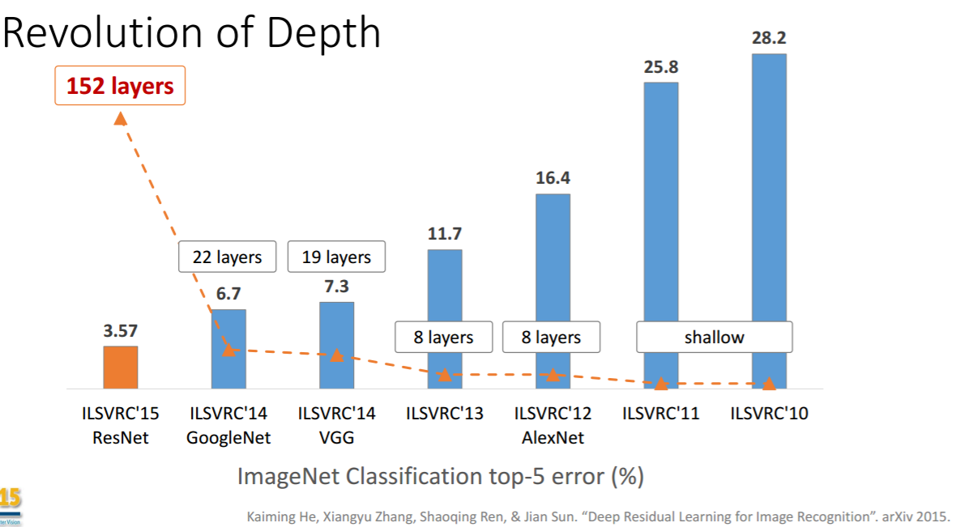

Convolutional Neural Networks (CNN)
CNN is a deep learning architecture.
Mainly consists of three main layers
Convolutional Layer
Pooling Layer
Fully Connected Layer

Slide 8
Literature Review
Image processing/ Statistical modeling based approaches [5-9]:
Hand gesture recognition with Hidden Markov Model (HMM) using Gabor features
Gesture recognition using Haar wavelet transform
British Sign Language recognition using Histogram of Oriented Gradients with HMM
Hand motion tracking with cyber glove and HMM
Classical Machine learning approaches [10-15]:
Hand gesture recognition using Support Vector Machines (SVM) with various standard features like Gabor features, SIFT features and shape descriptors.
Gesture recognition with Artificial Neural Networks (ANN) with various feature extraction techniques.
Deep learning based approaches [16-19]:
Italian Sign Language recognition using Convolutional Neural Networks (CNN).
American Sign Language recognition using depth map images to train CNN.
ASL recognition using re-trained Alexnet.

Slide 9
Our Approach
We pursued hand gesture recognition as an image classification problem.
Input to this system are real-time video frames (in RGB color space) from a general purpose web camera without additional peripherals like Depth sensors or data/cyber gloves.
Four independent convolutional neural networks are trained on Finger spelling ASL dataset and ensembled together for image classification.
A feedback system using head pose estimation is integrated to gesture recognition system to validate the classifier predictions.
Hypotheses:
Ensemble learning is expected to aggregate the bias in classification, reduce the variance and mitigate the chances of overfitting.
Integration of feedback system is expected to boost the overall system accuracy by choosing second best prediction in case of mis-classification in the first pass.

Slide 10


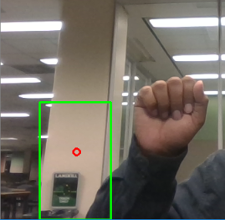
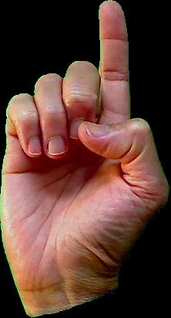

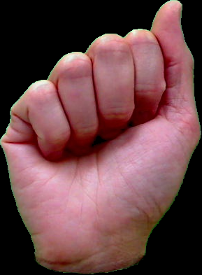
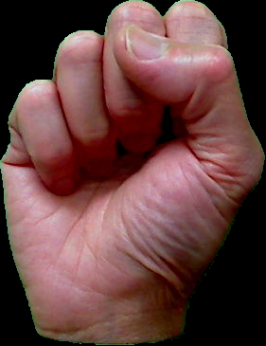
Challenges
Uncontrolled Environment
Robust Hand Detection
Occlusion
Low Inter-class Variability
Trigger to Recognition Process

Slide 11


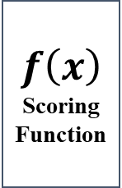
System Design
Hand Gesture Recognition
Input
Blink Detection
CNN
$$f\left(x\right)$$
Scoring Function
Facial Landmarks Extraction
Eye Aspect Ratio (EAR) Estimation
Blink Detection?
Hand Segmentation
CNN
Yes
CNN
CNN
No
No
Head Pose Estimation
Head nodded yes or no?
Head Orientation Estimation
Facial Landmarks Extraction
Yes
Hand Segmentation Pipeline
Real-time Face Detection
Dynamic skin color extraction from face
Adaptive binarization
Hand Localization with Convex hull

Slide 12
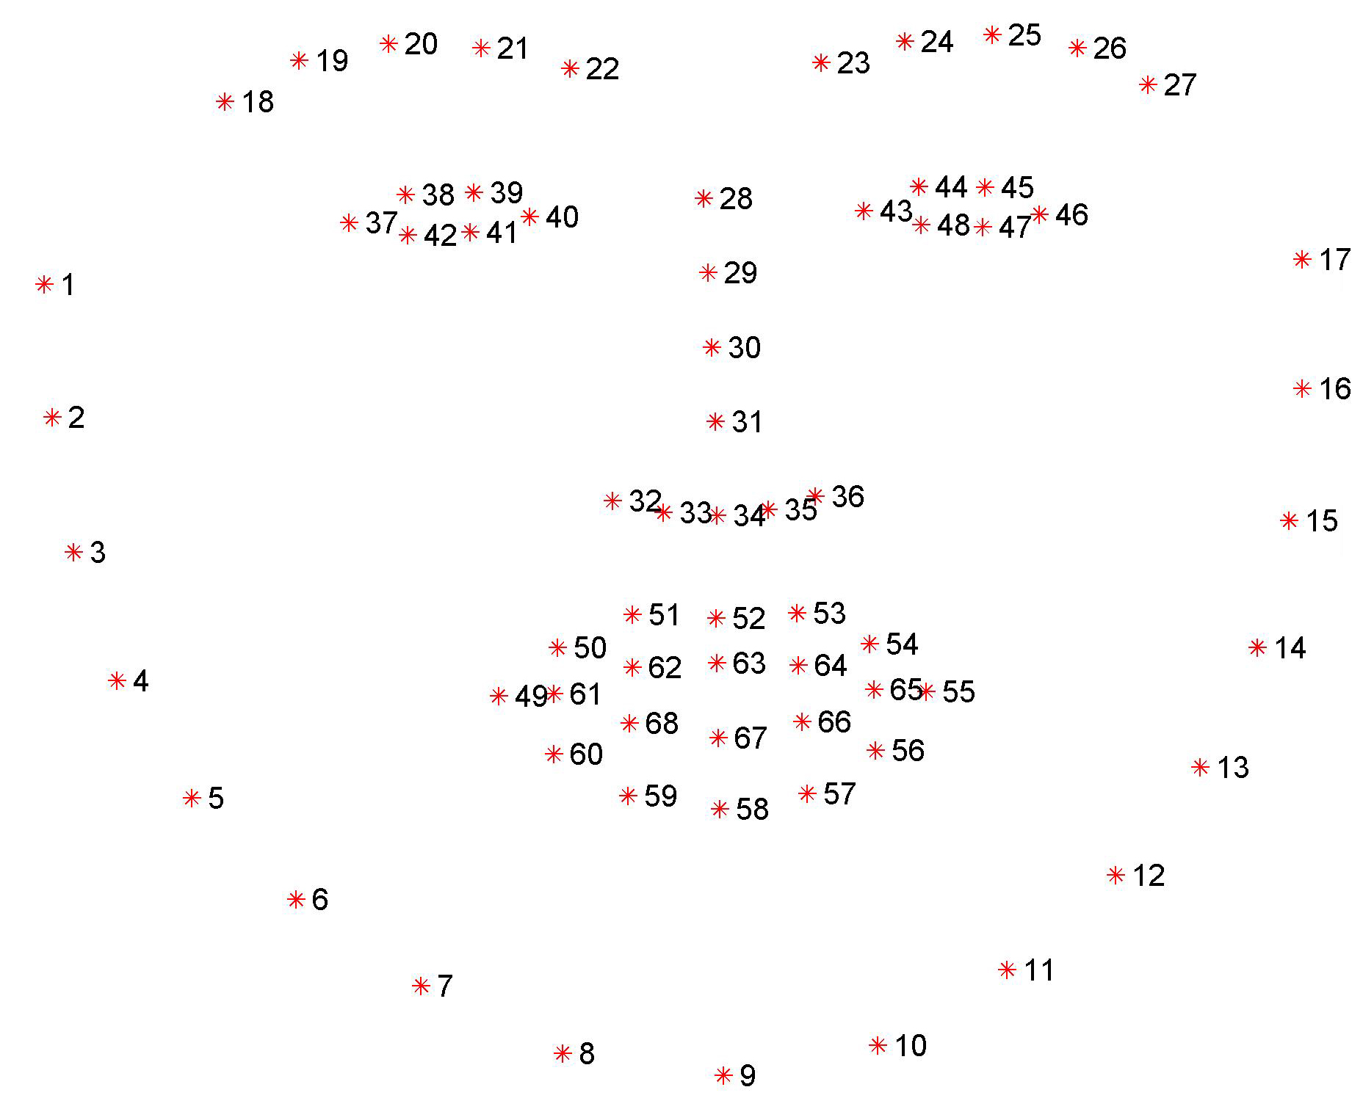
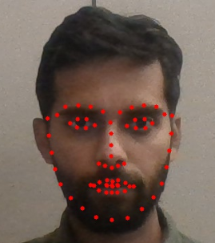
Facial Landmarking
It is computer vision technique to detect key points on human face.
In our system we use Dlib, a opensource computer vision library for facial landmark detection developed by Davis E. King et al.
Dlib provides a machine learning model trained on large set of faces through Histogram of Oriented Gradients+ Support Vector Machine.
The model provides 64 key points depicting various parts of face.

Slide 13
Implementation

Slide 14
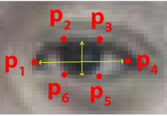

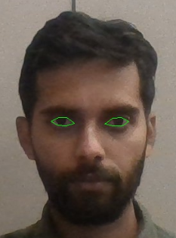
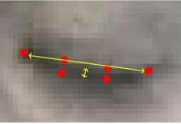
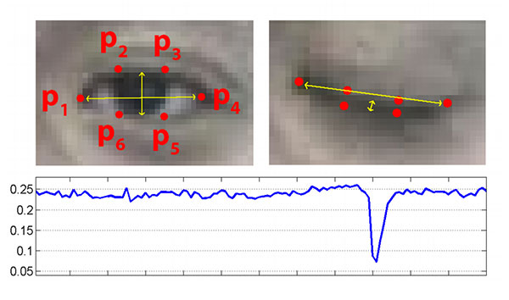
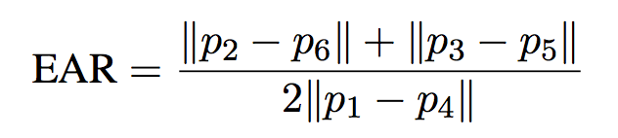
Blink Detection
Closed Eye
Input Face
Facial Landmark Extraction
Eye Region Extraction
Eye Aspect Ratio (EAR)
Calculation
EAR Calculation
Opened Eye

Slide 15
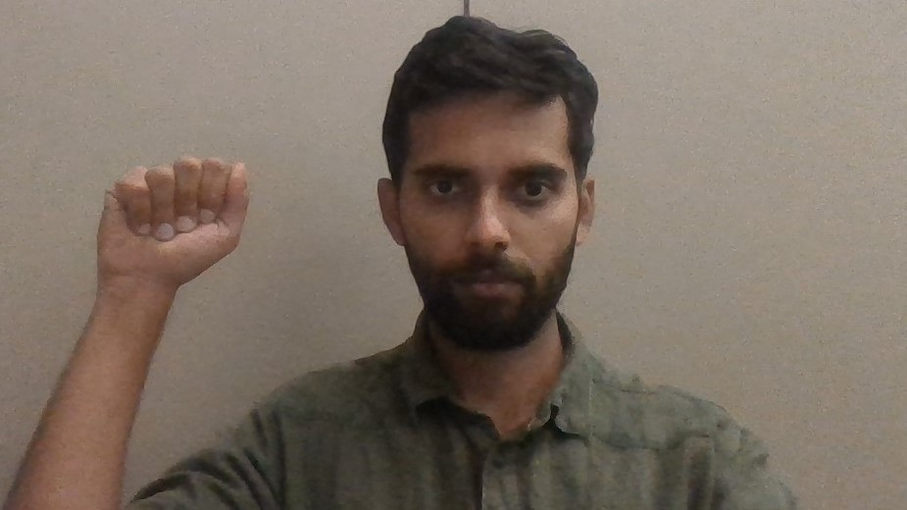
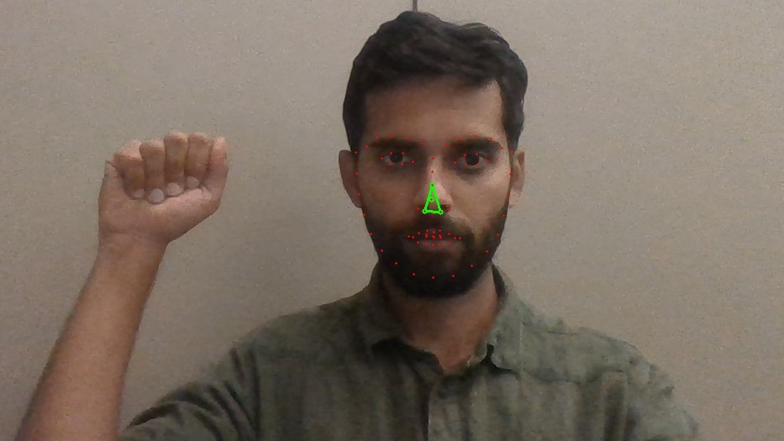
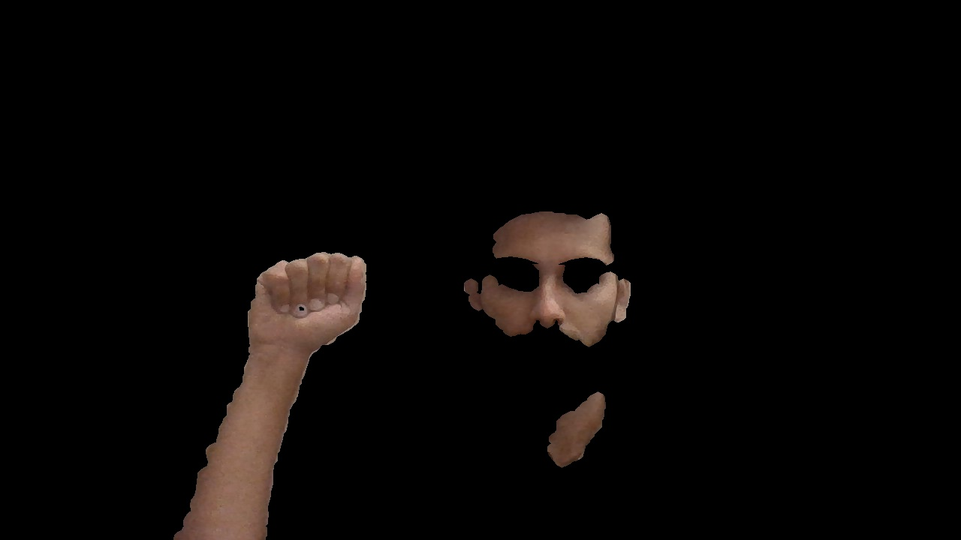
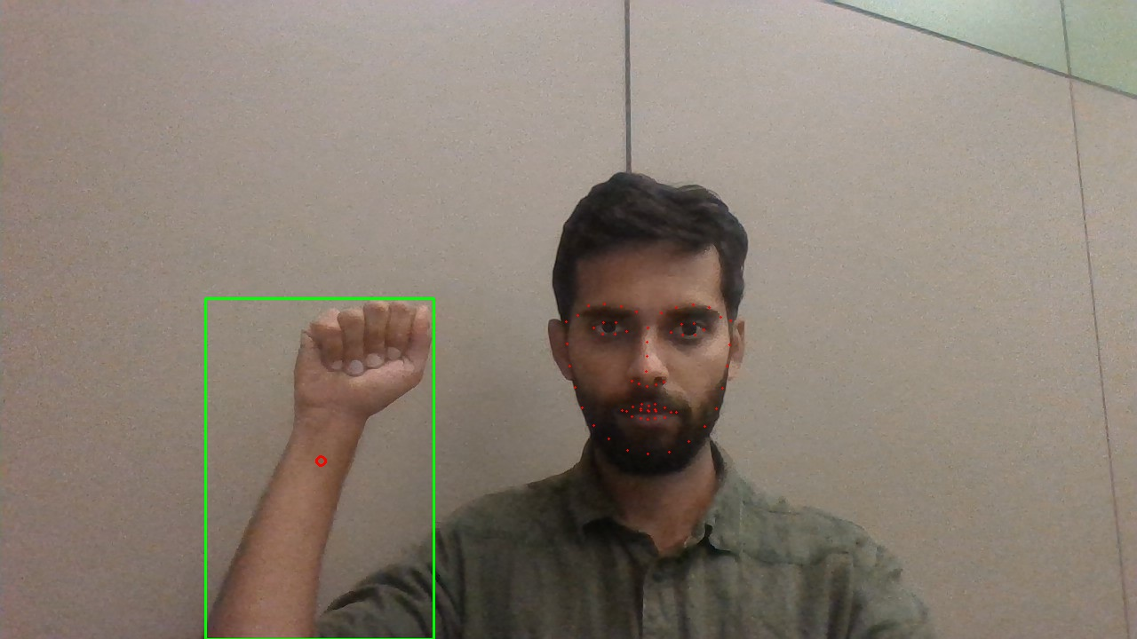
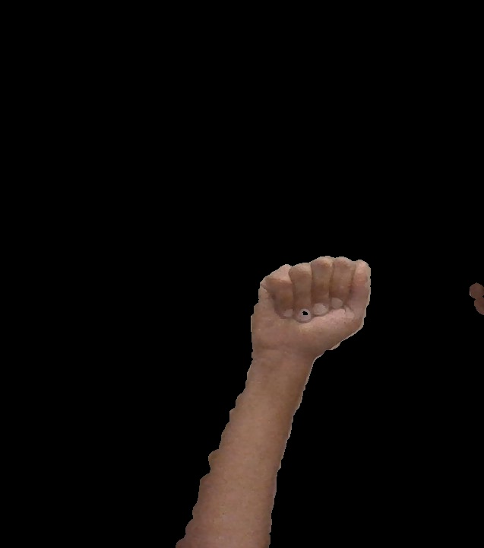
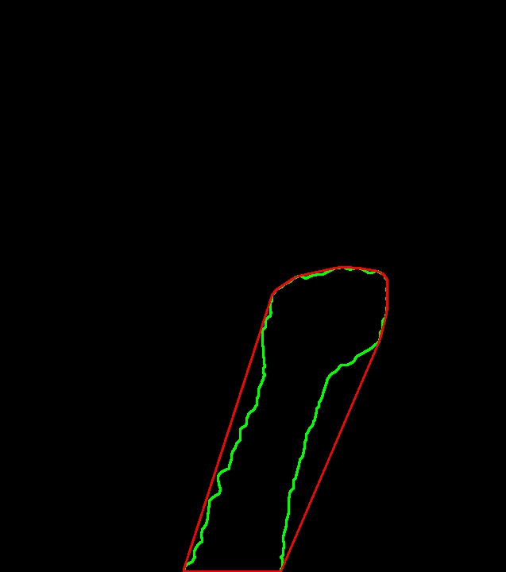

Hand Segmentation
Extracting Patch of Pixels for Skin Detection
Skin Region Extraction
Input Frame
Representation of Hand Region
Hand Segmentation
Contour Extraction using Convex Hull
Image Binarization

Slide 16
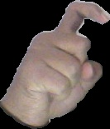

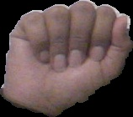
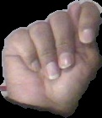

Hand Gesture Recognition
Training Phase
ASL Training Dataset
Training CNN
Validation & Testing
Saving Trained Model
Validation and Testing
Save Model
CNN
Recognition Phase
Ensembling
Input
CNN
$$f\left(x\right)$$
Scoring Function
Classification Output
Hand Segmentation
CNN
CNN
CNN

Slide 17
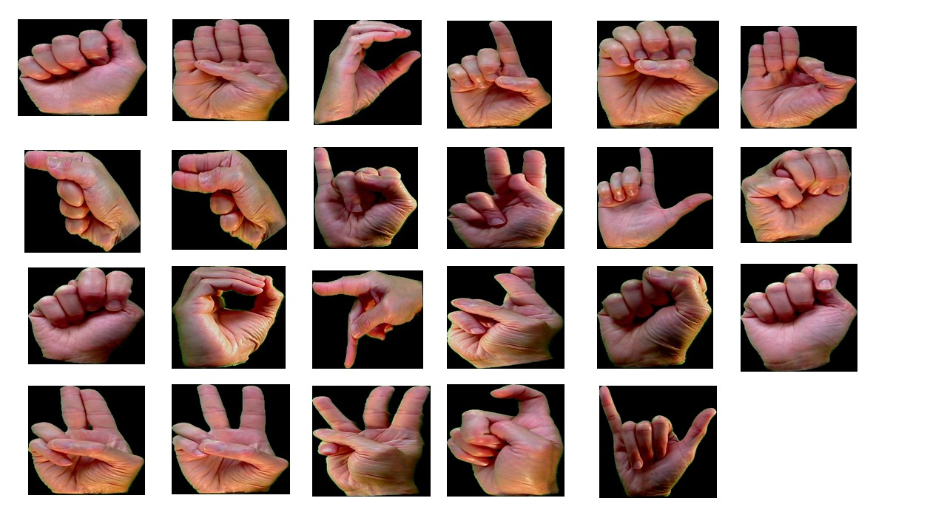
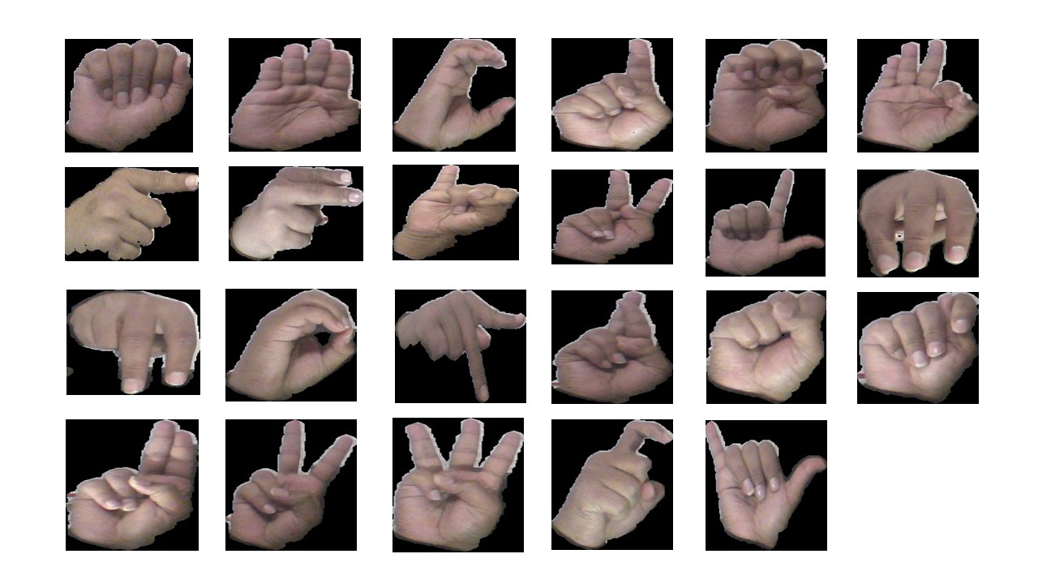
Training- Dataset
Our dataset consists of 25,254 image with 1098 image for each letter.
The dataset is a combination of images from Massey University standard ASL dataset and inhouse generated images.
The dataset comprises of hand gestures from 6 subjects under various lighting conditions.
Massey University ASL Dataset
Inhouse Generated ASL Dataset

Slide 18
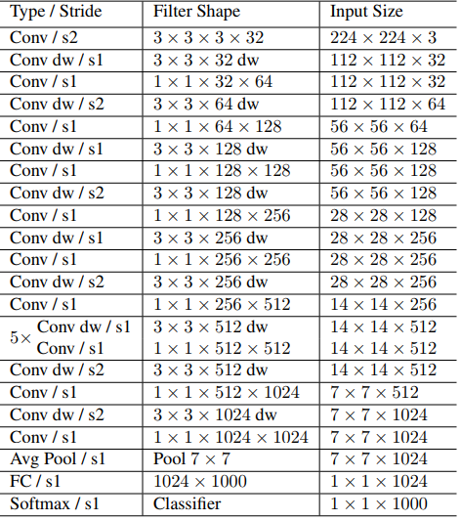
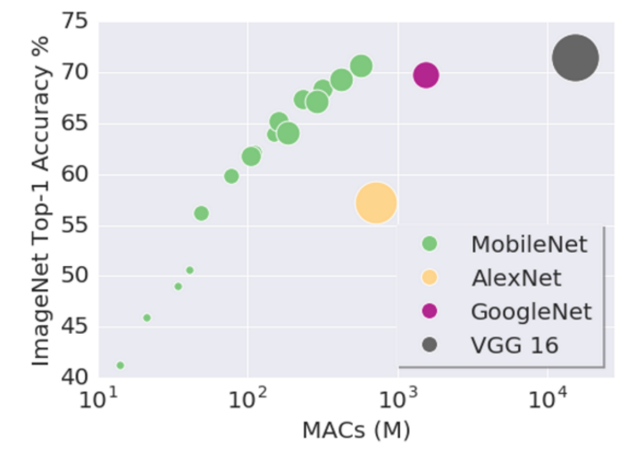
Training- CNN Architecture
In our system we used MobileNet, a modified version of GoogleNet architecture for training.
MobileNet is a mobile and embedded system compatible light weight CNN architecture.
Four independent MobileNets are trained through transfer learning and ensembled for recognition.
MobileNet Architecture

Slide 19
Training Configuration
We have trained four independent MobileNets at diﬀerent learning iterations using transfer learning technique.
In transfer learning, we import a pre-trained MobileNet whose weights for each layer obtained through training the ILSVRC dataset and re-initiate the ﬁnal classiﬁcation layer to optimize for the new target dataset, in this case ASL dataset.
Four Mobilenets are trained at 5000, 10000, 15000 and 20000 learning iterations with a learning rate of 0.001.
A dataset of 25,254 images with 1,098 images for each class are used for training out of which 10% of data is used for cross-validation.
The MobileNet architecture used for training accepts input images of size 224x224 and the batch size is set to 100 for both training and validation.

Slide 20
Ensemble of Convolutional Neural Networks
The independently trained MobileNets are ensembled by aggregating their individual conﬁdence scores which called bagging.
This bagging based scoring makes the system highly stable as it reduces the prediction variance.
We take 10 consecutive frames of single gesture and aggregate their conﬁdence scores for each classiﬁer to obtain a ﬁnal prediction conﬁdence to avoid misclassiﬁcation or low conﬁdence scores for gesture transition frames.
we capture 10 consecutive frames and aggregate their scores for each of the four CNNs. Later, a second level aggregation of scores obtained for all four learners is performed to obtain ﬁnal prediction score.

Slide 21
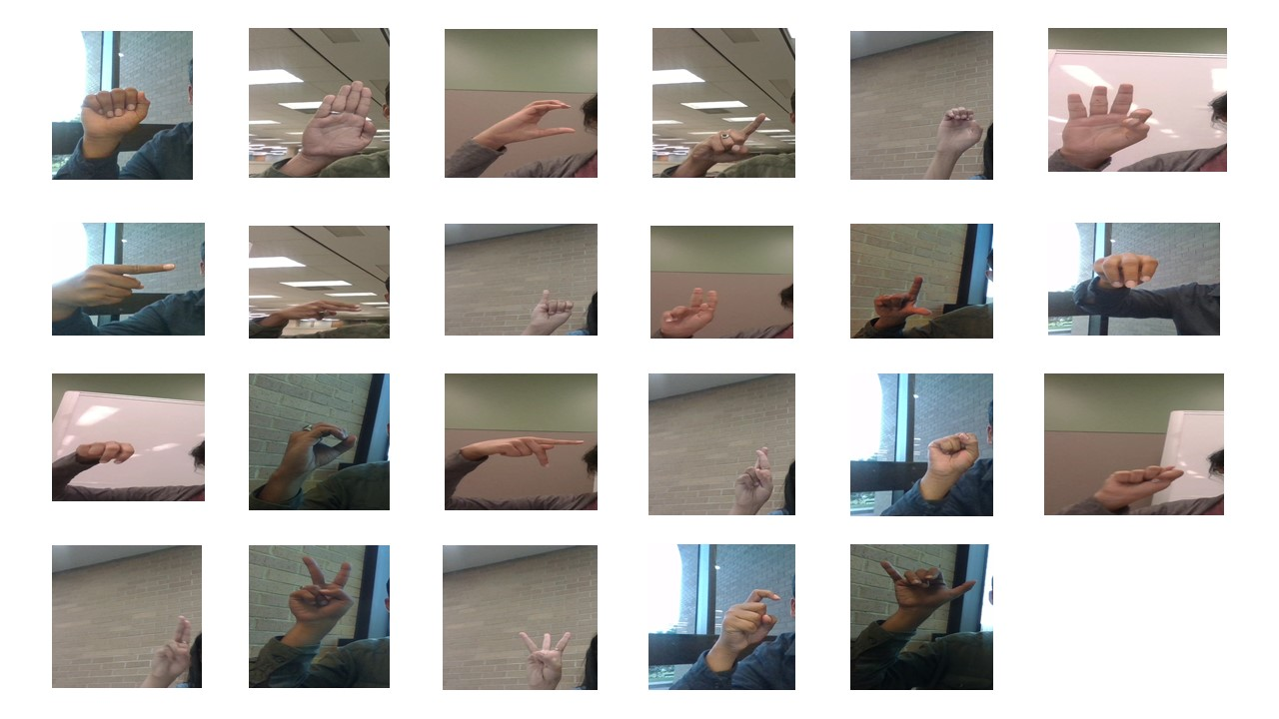
Validation and Testing
10% of the input dataset is used for validation i.e, 2525 images.
For testing, we have captured gesture images from 10 subjects under variable environmental conditions like complex background, variable lighting conditions, inclining the gesture posture, posing gesture close and far-way to the camera etc. 100 test images for each letter are generated and given to the testing module.
Test ASL Dataset

Slide 22
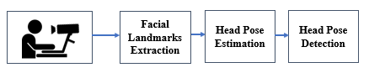
Head Pose Estimation
We approached head pose estimation as a perspective n point problem.
In this pipeline, we using Dlib facial landmarks for obtaining image coordinates of face.
Use the estimated 3D world coordinates for solving the perspective n point problem which will yield us rotation and translation vectors.
The obtained rotation and translation vectors are used to find the 2D projection which will yield us the head pose.

Slide 23
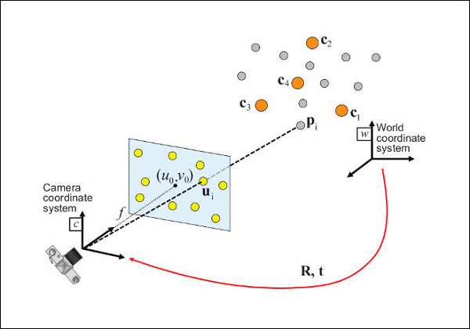
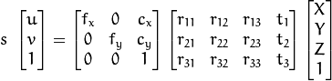
Solving Perspective n Point Problem
Here,
(u,v) are 2D coordinates in image plane of a 3D point (U,V,W)
(X,Y,Z) are the 3D coordinates of (u,v) in camera coordinate system
(fx,fy) are focal lengths and (cx,cy) are principal points

Slide 24
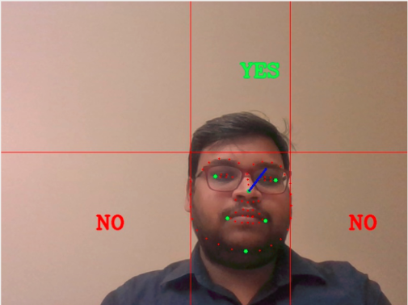
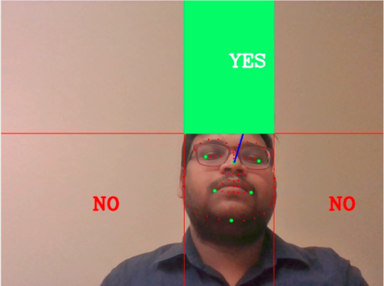
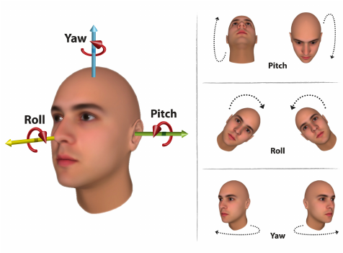
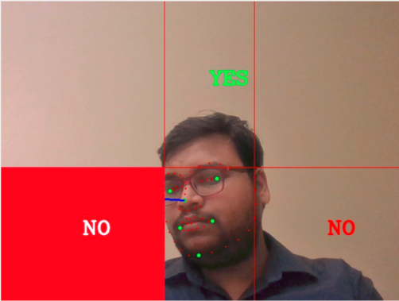
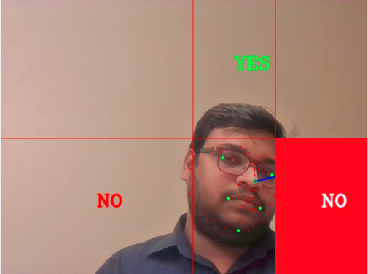
Head Pose Detection

Slide 25
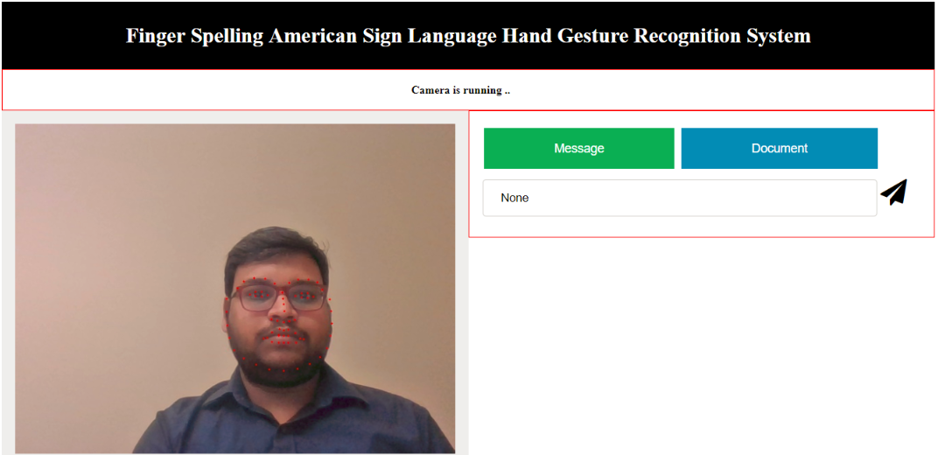
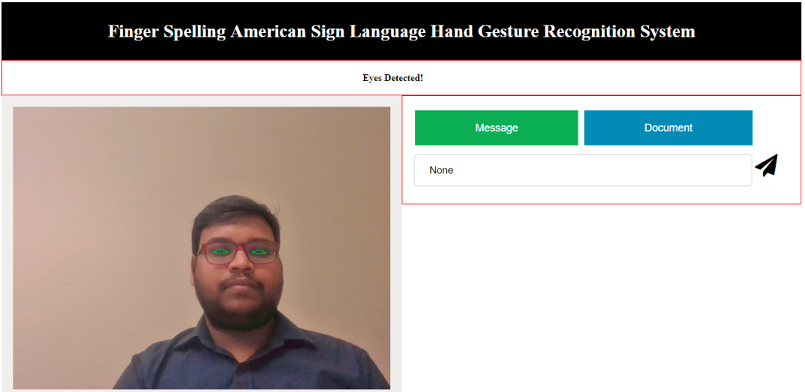
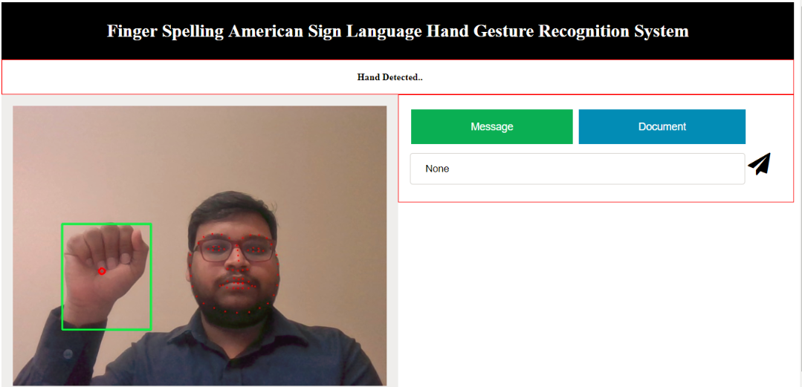
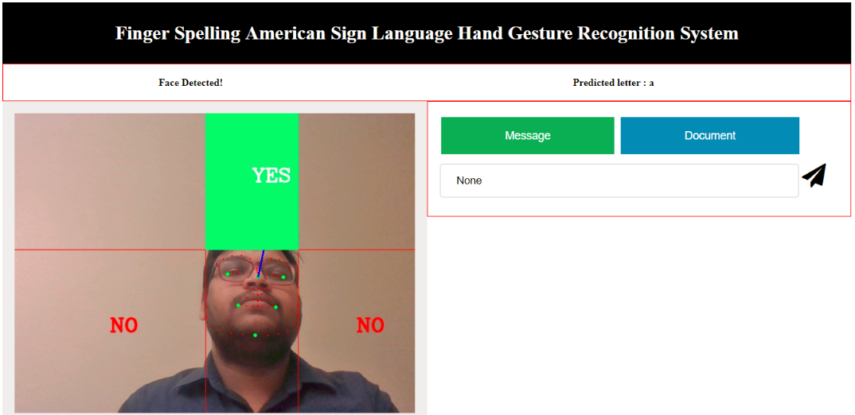
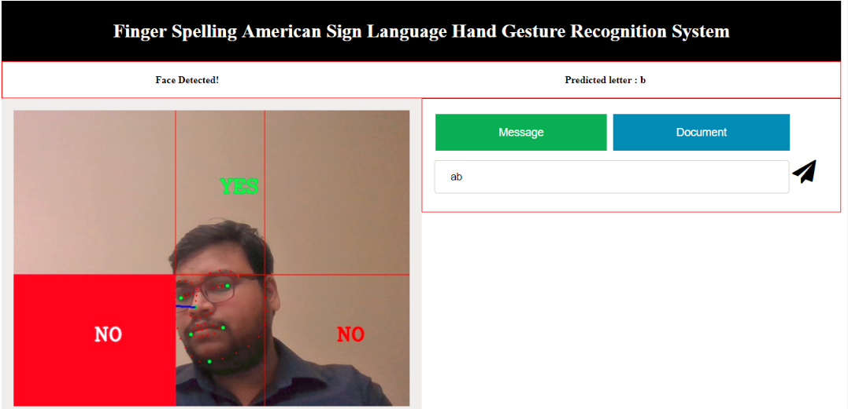
Overall System

Slide 26
Results

Slide 27
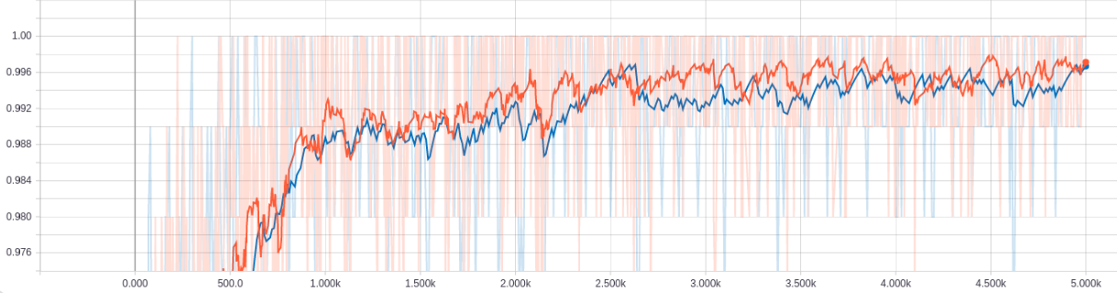
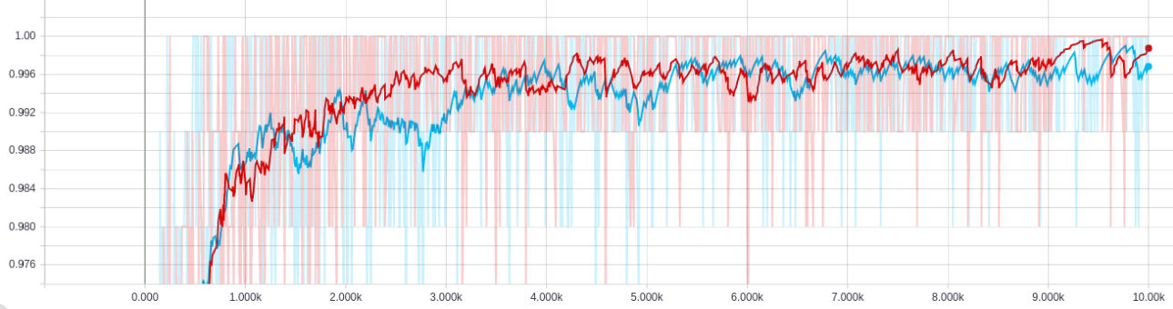
Training and Validation Accuracies
Accuracy
Training
Validation
Training Iterations (5000)
Accuracy
Training
Validation
Training Iterations (10000)

Slide 28
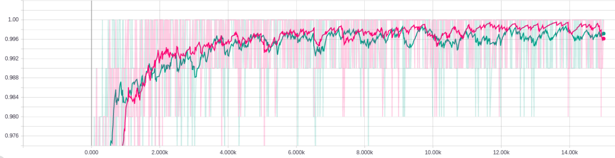
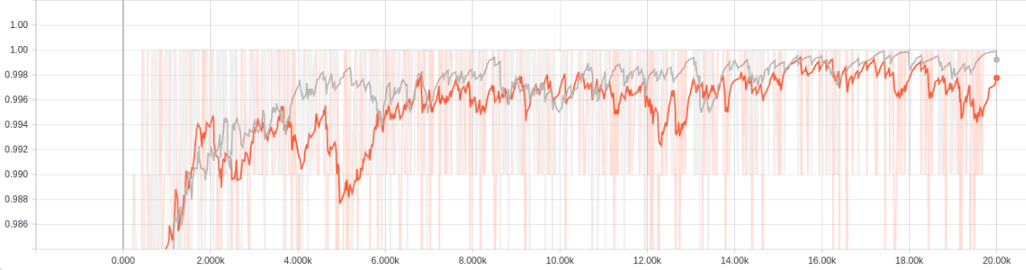
Training and Validation Accuracies
Accuracy
Training
Validation
Accuracy
Training Iterations (15000)
Training
Validation
Training Iterations (20000)

Slide 29
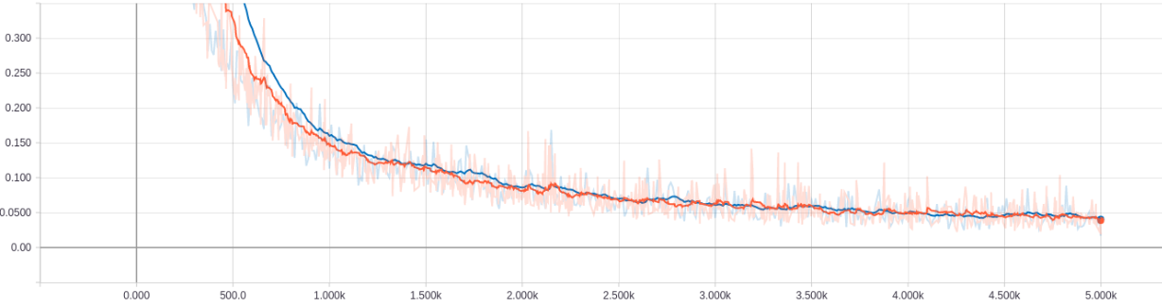

Cross Entropy
Cross Entropy
Training
Validation
Training Iterations (5000)
Cross Entropy
Training
Validation
Training Iterations (10000)

Slide 30


Cross Entropy
Cross Entropy
Training
Validation
Training Iterations (15000)
Cross Entropy
Training
Validation
Training Iterations (20000)

Slide 31


Confusion Matrix

Slide 32


Confusion Matrix

Slide 33


Confusion Matrix

Slide 34
Confusion Matrix

Slide 35


Confusion Matrix

Slide 36


Confusion Matrix

Slide 37




Comparison Plots

Slide 38
Summary of Results
Model | Training Accuracy (%) | Validation Accuracy (%) | Cross Entropy | Top-1 Test Accuracy (%) | Top-2 Test Accuracy (%)
MobileNet@5000 | 100 | 99 | 0.018 | 78 | 90
MobileNet@10000 | 100 | 99 | 0.016 | 81 | 90
MobileNet@15000 | 100 | 99 | 0.012 | 81 | 91
MobileNet@20000 | 100 | 99 | 0.13 | 82 | 91
Ensemble Model | - | - | - | 85 | 92

Slide 39
Discussion
The system has achieved a Top-1 accuracy of 85% and Top-2 accuracy of 92% with the ensembled technique.
In comparison with individual model accuracies ensembled model has achieved a consistent accuracy of more that 72% for each letter except for letters ‘U’ and ‘V’.
For every model there is difference of approximately 5-10% between Top-1 and Top-2 accuracies which signifies that feedback system using head pose estimation as improved the efficiency of the system.
These results validate our hypotheses that,
ensemble learning aggregates the bias in classification, reduces the variance and mitigates the chances of overfitting.
Incorporation of feedback system is expected to boost the overall system accuracy by choosing second best prediction in case of mis-classification in the first pass.

Slide 40
Future Work
Training letters ’J’,’Q’ and ’Z’ for gesture recognition:
The current system is not trained to recognize gestures for letters ’J’, ’Q’ and ’Z’.
’J’ and ’Z’ involves spatio-temporal details for gesture classiﬁcation, where as our system deals with static image classiﬁcation.
These gestures can be recognized by implementing hand motion tracking and memory based deep learning algorithms like LSTMs.
Deep learning based hand segmentation:
Hand detection using object detection techniques like SSD, Yolo, FastRNN will improve the precision in hand segmentation
Integrating auto word/sentence completion techniques:
Using latest Natural Language Processing (NLP) techniques like N grams or Bidirectional LSTMs based predictive models for auto-completion of words and sentences.
Implementing Reinforcement Learning based gesture recognition model:
Reinforcement learning model performs current actions by drawing inferences from previous failures.
Incorporating such model into our system can use our feedback system to learn from it’s mistakes.

Slide 41
Conclusion
We are successful in developing a real-time American sign language recognition system without any special equipment like kinect 3D camera or data glove.
This system performs gesture recognition using Mobilenets a mobile and embedded system compatible CNN architecture.
Along with a standard dataset from Massey university we have created our own ASL dataset for training four independent mobilenet models. Ensembling of these four models through bagging approach has yielded an overall accuracy of 92% in classiﬁcation and helped in obtaining near uniform accuracy across all the letters.
In extension to the core system, head pose estimation based feedback unit which is inspired from natural way of expressing acceptance or denial through head nodding is successfully implemented and observed to boost the overall classiﬁcation accuracy.
The entire system is developed using Python, Opencv and Tensorﬂow and deployed as a web application using Flask to make it operating system independent.

Slide 42
References
[1] Mitchell, Ross; Young, Travas; Bachleda, Bellamie; Karchmer, Michael (2006). ”How Many People Use ASL in the United States?: Why Estimates Need Updating” (PDF), Sign Language Studies (Gallaudet University Press.) 6 (3). ISSN 0302-1475. Retrieved January 12, 2018.
[2] ”How Computer Vision Is Finally Taking Oﬀ, After 50 Years”. Youtube, Uploaded by Nat and Friends, 3 May 2017, https://www.youtube.com/watch?v=eQLcDmfmGB0
[3] Wikipedia contributors, ’Deep learning’, Wikipedia, The Free Encyclopedia, 19 June 2018, 14:24 UTC, https://en.wikipedia.org/w/index.php?title=Deep_learning&oldid=846560569 [accessed 19 June 2018]
[4] Howard A.G., Zhu M., Chen B. and Kalenichenko D. ”MobileNets: Eﬃcient Convolutional Neural Networks for Mobile Vision Applications”, eprint arXiv:1704.04861, April 2017
[5] Triesch J. and Malsburg C., Robust Classiﬁcation of Hand Postures against Complex Backgrounds, Proceedings of the Second International Conference on Automatic Face and Gesture Recognition, Killington, VT,1996, pp. 170-175.
[6] M. A. Amin and H. Yan, ”Sign Language Finger Alphabet Recognition from Gabor PCA Representation of Hand Gestures”, 2007 International Conference on Machine Learning and Cybernetics, Hong Kong, 2007, pp. 2218-2223.
[7] D. Y. Huang, W. C. Hu and S. H. Chang, ”Vision-Based Hand Gesture Recognition Using PCA+Gabor Filters and SVM,” 2009 Fifth International Conference on Intelligent Information Hiding and Multimedia Signal Processing, Kyoto, 2009, pp.1-4.

Slide 43
References
[8] R. Gopalan and B. Dariush, ”Toward a vision based hand gesture interface for robotic grasping,” 2009 IEEE/RSJ International Conference on Intelligent Robots and Systems, St. Louis, MO, 2009, pp. 1452-1459.
[9] C. Savur and F. Sahin, ”Real-Time American Sign Language Recognition System Using Surface EMG Signal,” 2015 IEEE 14th International Conference on Machine Learning and Applications (ICMLA), Miami, FL, 2015, pp. 497-502.
[10] K. O. Rodrguez and G. C. Chvez, ”Finger Spelling Recognition from RGB-D Information Using Kernel Descriptor,” 2013 XXVI Conference on Graphics, Patterns and Images, Arequipa, 2013, pp. 1-7.
[11] C. H. Chuan, E. Regina and C. Guardino, ”American Sign Language Recognition Using Leap Motion Sensor,” 2014 13th International Conference on Machine Learning and Applications, Detroit, MI, 2014, pp. 541-544.
[12] N. Dardas, Q. Chen, N. D. Georganas and E. M. Petriu, ”Hand gesture recognition using Bag-of- features and multi-class Support Vector Machine,” 2010 IEEE International Symposium on Haptic Audio Visual Environments and Games, Phoenix, AZ, 2010, pp. 1-5.
[13] M. V. Lamari, M. S. Bhuiyan and A. Iwata, ”Hand alphabet recognition using morphological PCA and neural networks,” Neural Networks, 1999. IJCNN ’99. International Joint Conference on, Washington, DC, 1999, pp. 2839-2844 vol.4.

Slide 44
References
[14] P. Mekala, Y. Gao, J. Fan and A. Davari, ”Real-time sign language recognition based on neural network architecture,” 2011 IEEE 43rd Southeastern Symposium on System Theory, Auburn, AL, 2011, pp. 195-199.
[15] Y. F. Admasu and K. Raimond, ”Ethiopian sign language recognition using Artiﬁcial Neural Network,” 2010 10th International Conference on Intelligent Systems Design and Applications, Cairo, 2010, pp. 995-1000.
[16] J. Nagi, F. Ducatelle, G. Di Caro, D. Ciresan, U. Meier, A. Giusti, F. Nagi, J.Schmidhuber, and L. Gambardella. ” Max-pooling convolutional neural networks for vision-based hand gesture recognition.”, In Signal and Image Processing Applications (ICSIPA), 2011 IEEE International Conference on, pages 342347, Nov 2011.
[17] B. Kang, S. Tripathi, T. Q. Nguyen”Real-time Sign Language Fingerspelling Recognition using Convolutional Neural Networks from Depth map” arXiv:1509.03001,2015
[18] V. Bheda, D. Radpour”Using Deep Convolutional Networks for Gesture Recognition in American Sign Language”, arXiv:1710.06836, 2017
[19] M. Van den Bergh and L. Van Gool. ”Combining rgb and tof cameras for real-time 3d hand gesture interaction.”, In Applications of Computer Vision (WACV), 2011 IEEE Workshop on, pages 6672, Jan 2011

Slide 45
References
[20] Ashutosh, A. Singh, S. Banerjee and S. Chaudhury, ”A gesture based interface for re mote robot control,” TENCON ’98. 1998 IEEE Region 10 International Conference on Global Connectivity in Energy, Computer, Communication and Control, New Delhi, 1998, pp. 158- 161 vol.1.
[21] T. Kapuscinski and M. Wysocki, ”Hand gesture recognition for man-machine interaction,” Robot Motion and Control, 2001 Proceedings of the Second International Workshop on, BukowyDworek, 2001, pp. 91-96.
[22] T. Starner and A. Pentland, ”Real-time American Sign Language recognition from video using hidden Markov models,” Proceedings of International Symposium on Computer Vision - ISCV, Coral Gables, FL, 1995, pp. 265-270.
[23] B. Garcia S. A. Viesca ”Real-time American Sign Language Recognition with Convolutional Neural Networks”, CS231n Stanford University, 2016
[24] L. Pigou, S. Dieleman, P.-J. Kindermans, and B. Schrauwen. ” Sign language recognition using convolutional neural networks.”, In Computer Vision - ECCV 2014 Workshops, pages572578, 2015.
[25] S. Liwicki and M. Everingham. ” Automatic recognition of ﬁngerspelled words in british sign language.”, In Computer Vision and Pattern Recognition Workshops, 2009. CVPRWorkshops 2009. IEEE Computer Society Conference, pages 5057, June 2009.

Slide 46
References
[26] S. Mallick. ”Head Pose Estimation using OpenCV and Dlib,” www.learnopencv.com, September
26, 2016. [Online]. Available: https://www.learnopencv.com/head-pose-estimation- usingopencv-and-dlib/. [Accessed: Mar 10th 2017].
[27] T. Soukupov and J. Cech. ”Real-Time Eye Blink Detection using Facial Landmarks.”,2016
[28] A. L. C.Barczak, N. H. Reyes, Mary E Abastillas, A. Piccio and Teo Susnjak. A New 2 D Static Hand Gesture Colour Image Dataset for ASL Gestures. ,2012.
[29] A. G. Howard, M. Zhu, B. Chen, D. Kalenichenko, W. Wang, T. Weyand, M. Andreetto, H. Adam ”MobileNets: Eﬃcient Convolutional Neural Networks for MobileVision Applications”, arXiv:1704.04861, 2017
[30] Opencv, ”Real Time pose estimation of a textured object,” docs.opencv.org, November 10, 2014.[Online].Available: http://docs.opencv.org/3.0beta/doc/tutorials/calib3d/real_time_pose/real_time_pose.hml . [Accessed: Mar 15th,2017].
[31] G. Bradski ”The OpenCV Library”, Pubished in Dr. Dobb’s Journal of SoftwareTools, 2000
[32] G. van Rossum, ”Python tutorial, Technical Report CS-R9526”, Centrum voor Wiskunde en Informatica (CWI), Amsterdam, May 1995.
[33] . E. King ”Dlib-ml: A Machine Learning Toolkit”, Published in Journal of Machine Learning Research, 2009 vol 10 pp 1755-1758

Slide 47
Acknowledgements
I would like to express my sincere gratitude to my advisor Dr. Kamesh Namuduri for all his guidance and support and Dr. Bill P. Buckles for your valuable inputs. It is my privilege working under veterans like you.
I would also like to thank my web gurus, Dr. Andrew Ng, Dr. Satya Mallick and Dr. Adrian Rosebrock. A lot of your lecture, tutorials and blogposts were very useful for this project.
And my special thanks to my parents Shri Venkata SubbaRao Viswavarapu, Shri Siva Durga Rani Viswavarapu for all you support to pursue my passion and my friends for standing with me during all my hurdles.

Slide 48

Thank You

